Slide 1
Symbol Maps

Slide 2
Symbol Maps
symbol maps are great for showing quantitative values for individual locations.
They can show one or two quantitative values per location (one value encoded with size, and, if necessary, another encoded with color).
For example, you can plot earthquakes recorded between 1981 to 2014 around the world, and size them by magnitude.
You can also color the data points by magnitude for additional visual detail.

Slide 3
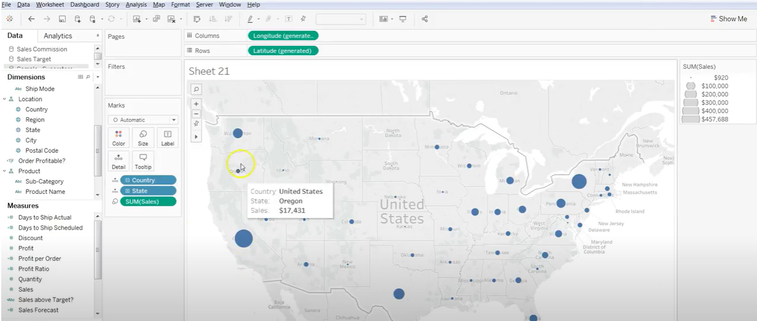
Creation of Symbol Maps

Slide 4
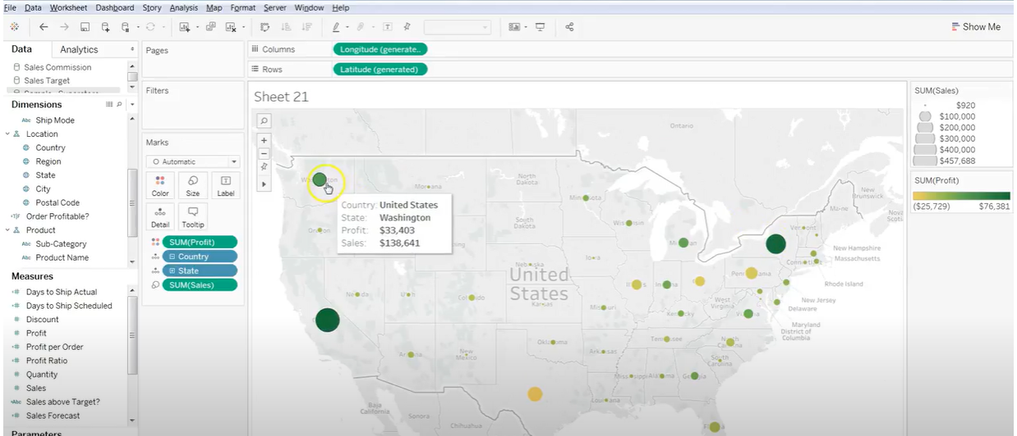
Creation of Symbol Maps

Slide 5
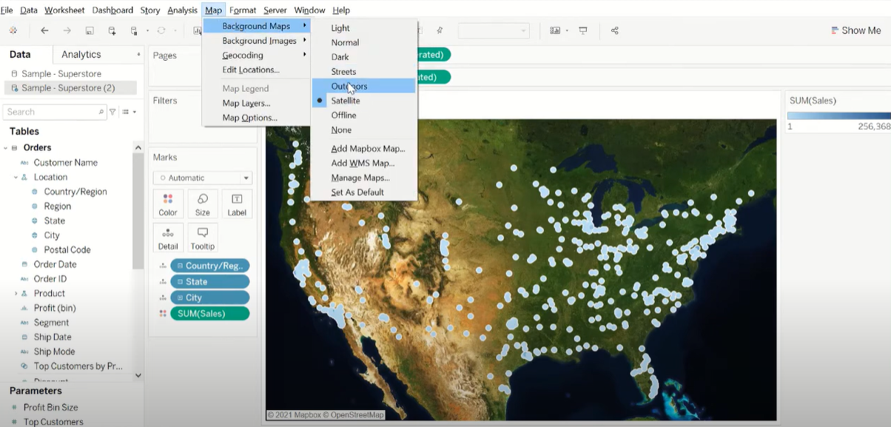
Map Box

